Slide 1
John Carmack: The Legend of 3D Game Development
The man who made DOOM…
Notes:
AI-generated content may be incorrect. --- This presentation explores the life and achievements of John Carmack, a pioneering figure in 3D game programming and technology. We will delve into his early life, groundbreaking innovations, and lasting impact on the gaming and technology world.

Slide 2
Agenda Overview
Introducing John Carmack: Pioneer of 3D Game Programming
Groundbreaking Contributions to Video Game Technology
Technological Innovations and Advancements
Expanding Horizons: Beyond Game Development
Carmack’s Enduring Legacy and Influence
Notes:
We will begin by introducing John Carmack and his rise to prominence. Next, we will examine his major contributions to video game technology and key innovations. Then, we will explore his ventures beyond gaming and conclude with an overview of his enduring legacy.

Slide 3
Introducing John Carmack: Pioneer of 3D Game Programming
Notes:
John Carmack is widely recognized as a revolutionary programmer in the gaming industry. His early life, career at Id Software, and recognition as a technology leader set the stage for his influential work.

Slide 4

Background and Early Life of John Carmack
Early Passion for Programming
John Carmack demonstrated a strong enthusiasm for programming and technology from an early age.
Dedication to Problem-Solving
His commitment to coding and solving technical challenges laid the foundation for his future innovations.
Path to Game Development
These early experiences and skills enabled him to become a pioneer in the video game industry.
Notes:
--- John Carmack grew up with a passion for programming and technology, showing early signs of brilliance. His dedication to coding and problem-solving paved the way for his future innovations in game development. Image source: Microsoft 365 content library

Slide 5
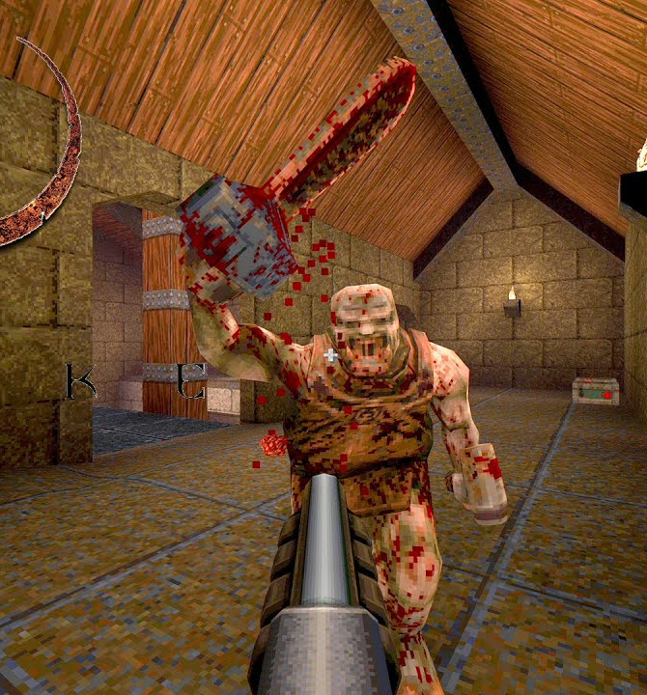
Career at Id Software and Rise to Prominence
Role in Game Development
Carmack was instrumental in creating iconic first-person shooter games that shaped the gaming industry.
Technical Expertise
His advanced technical skills and creativity significantly contributed to the success of Id Software.
Industry Impact
Carmack's work helped elevate Id Software to a leading position in the video game industry.
Notes:
--- At Id Software, Carmack played a crucial role in developing iconic games that defined the first-person shooter genre. His technical expertise and creativity helped elevate the company to a leading position in the industry. Image source: Microsoft 365 content library

Slide 6

Recognition as a Leader in Gaming Technology
Breakthroughs in Graphics Programming
Innovations in graphics programming revolutionized gaming visuals and performance.
Recognition Among Gamers
His work earned admiration and respect within the gaming community worldwide.
Respect in Technology Community
Acknowledged as a pioneer in technology beyond gaming, influencing broader tech innovations.
Notes:
--- Carmack's breakthroughs in graphics programming earned him widespread recognition. He became a respected figure not only among gamers but also within the broader technology community. Image source: Microsoft 365 content library

Slide 7
Groundbreaking Contributions to Video Game Technology
Notes:
Carmack revolutionized the gaming world with innovations in game engines and real-time 3D rendering, deeply influencing the evolution of first-person shooters.

Slide 8

Innovation in Game Engines for Wolfenstein 3D, Doom, and Quake
Wolfenstein 3D Engine
Introduced pioneering 3D graphics that enhanced player immersion and set new standards for FPS games.
Doom Engine Advances
Expanded 3D rendering capabilities and level design complexity, revolutionizing gameplay dynamics.
Quake Engine Innovation
Featured full 3D environment and real-time lighting effects, greatly improving visual realism.
Notes:
--- Carmack developed revolutionary game engines for Wolfenstein 3D, Doom, and Quake, which introduced new levels of immersion and gameplay through advanced 3D graphics and design. Image source: Microsoft 365 content library

Slide 9

Development of Real-Time 3D Rendering Techniques
Real-Time 3D Rendering
Pioneering techniques enabled rendering of 3D graphics in real-time, enhancing visual experiences in games.
Fast and Responsive Gameplay
These methods allowed games to be more interactive and fluid, improving player experience despite hardware limits.
Efficient Hardware Utilization
Techniques optimized rendering performance, enabling complex visual effects on limited hardware resources.
Notes:
--- He pioneered techniques that allowed for real-time 3D rendering, making fast and responsive gameplay possible even with limited hardware resources at the time. Image source: Microsoft 365 content library

Slide 10

Influence on the Evolution of the First-Person Shooter Genre
Defining FPS Game Design
His contributions established core principles that shaped FPS game mechanics and player interaction.
Multiplayer Functionality
Innovations introduced multiplayer modes that foster competitive and cooperative play among users.
Immersive Environments
The design of engaging and realistic game worlds enhanced player immersion and experience.
Notes:
--- His work helped define the FPS genre, setting standards for game design, multiplayer functionality, and immersive environments that still resonate in modern games. Image source: Microsoft 365 content library

Slide 11
Technological Innovations and Advancements
Notes:
Beyond game engines, Carmack introduced important optimizations and spatial techniques that pushed hardware limits and enhanced game performance.

Slide 12
Implementation of Binary Space Partitioning (BSP)
Efficient Rendering Management
BSP enables efficient rendering by dividing 3D spaces into manageable partitions for faster graphics processing.
Collision Detection Optimization
BSP improves collision detection by organizing space to quickly determine object interactions within complex environments.
Handling Complex 3D Environments
BSP facilitates smooth display of detailed 3D environments by efficiently managing scene complexity and visibility.
Notes:
--- Carmack utilized Binary Space Partitioning to efficiently manage rendering and collision detection, enabling complex 3D environments to be displayed smoothly. Image source: Microsoft 365 content library

Slide 13

Surface Caching, Lightmaps, and Optimization Techniques
Surface Caching
Surface caching stores precomputed graphical data to speed up rendering and reduce processing load during scene display.
Lightmapping Techniques
Lightmapping applies pre-calculated lighting information to scenes, enhancing visual quality and realism efficiently.
Optimization Benefits
These methods optimize scene rendering and lighting, improving performance while maintaining high visual fidelity.
Notes:
--- He developed surface caching and lightmapping methods that enhanced visual quality and performance by optimizing how scenes were rendered and lit. Image source: Microsoft 365 content library

Slide 14
Real-Time 3D Engines and Pushing Hardware Boundaries
Pushing Hardware Limits
Innovative techniques maximized hardware capabilities to enhance game performance and visuals beyond prior limits.
Dynamic Game Worlds
Enabled creation of more detailed and interactive 3D environments for immersive gameplay experiences.
Foundation for Modern 3D Engines
Developed pioneering technologies that became the basis for today's advanced real-time 3D engines.
Notes:
--- Carmack consistently pushed the limits of available hardware, enabling more detailed and dynamic game worlds, setting the foundation for modern 3D engines. Image source: Microsoft 365 content library

Slide 15
Expanding Horizons: Beyond Game Development
Notes:
Carmack's talents extended beyond games into aerospace and virtual reality, where he applied his skills to pioneering new technologies and industries.

Slide 16
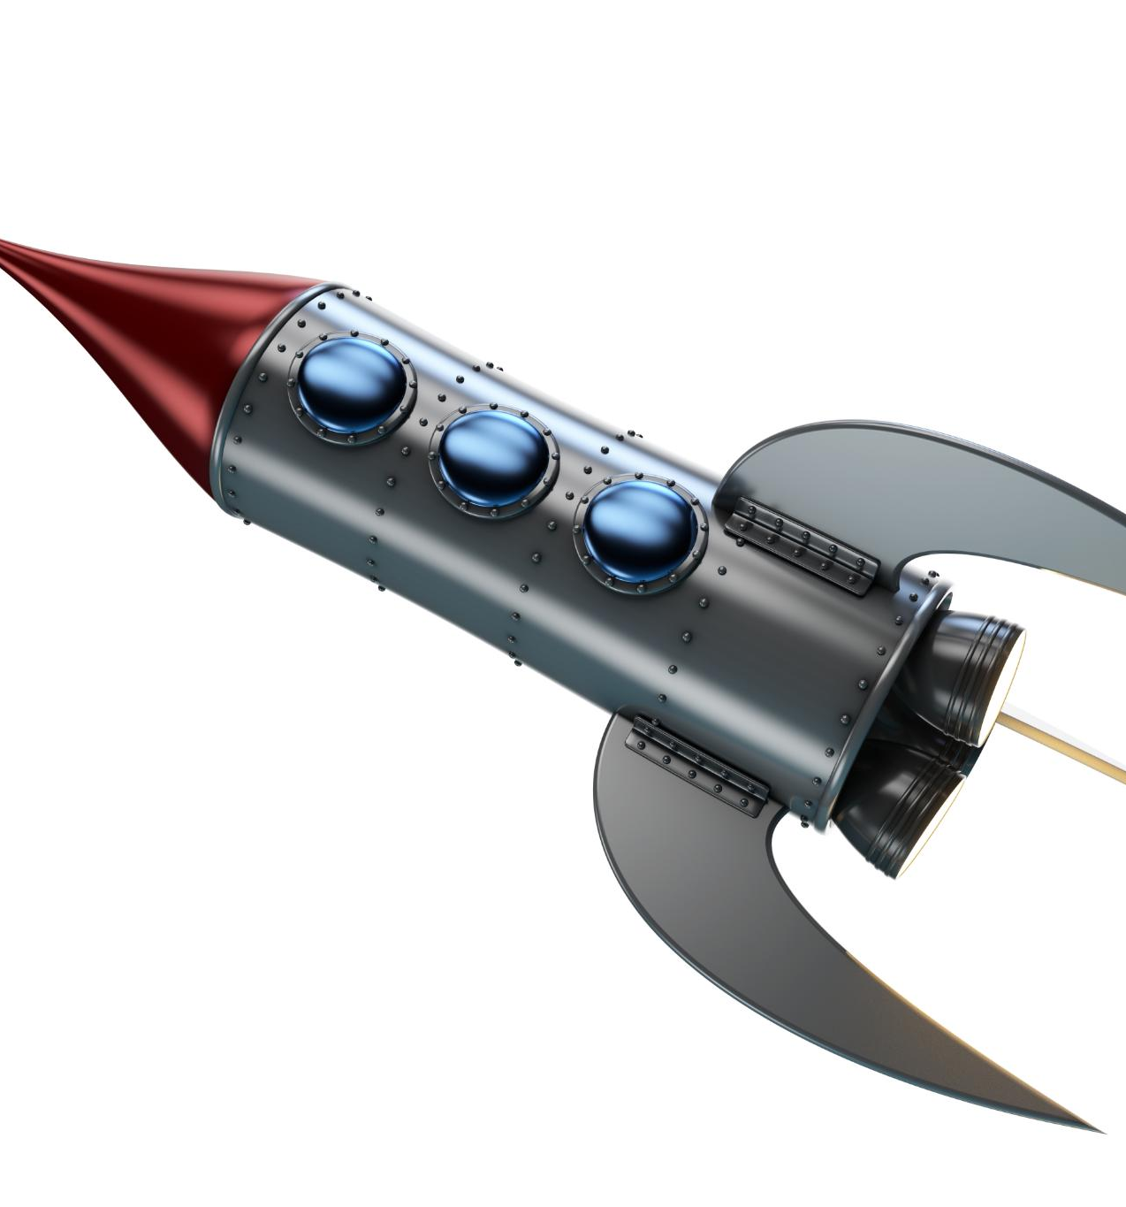
Ventures in Aerospace Engineering with Armadillo Aerospace
Foundation of Aerospace Company
He established a company dedicated to advancing rocket and spacecraft technology for space exploration.
Innovation in Spacecraft Technology
Focused on developing innovative spacecraft technologies that push the boundaries of aerospace engineering.
Passion for Engineering and Exploration
Demonstrated strong passion for engineering and exploration beyond the gaming industry.
Notes:
--- He founded Armadillo Aerospace, focusing on innovative rocket and spacecraft technology, demonstrating his passion for engineering and exploration outside gaming. Image source: Microsoft 365 content library

Slide 17

Leadership in Virtual Reality Technology at Oculus VR
Technical Leadership in VR
Leadership played a crucial role in advancing VR technology at Oculus VR through innovation and development.
Advancing Immersive Experiences
Efforts focused on making VR experiences more immersive and accessible to a wider consumer base.
Notes:
--- At Oculus VR, Carmack led technical development efforts that helped advance VR technology, making immersive experiences more accessible to consumers. Image source: Microsoft 365 content library

Slide 18
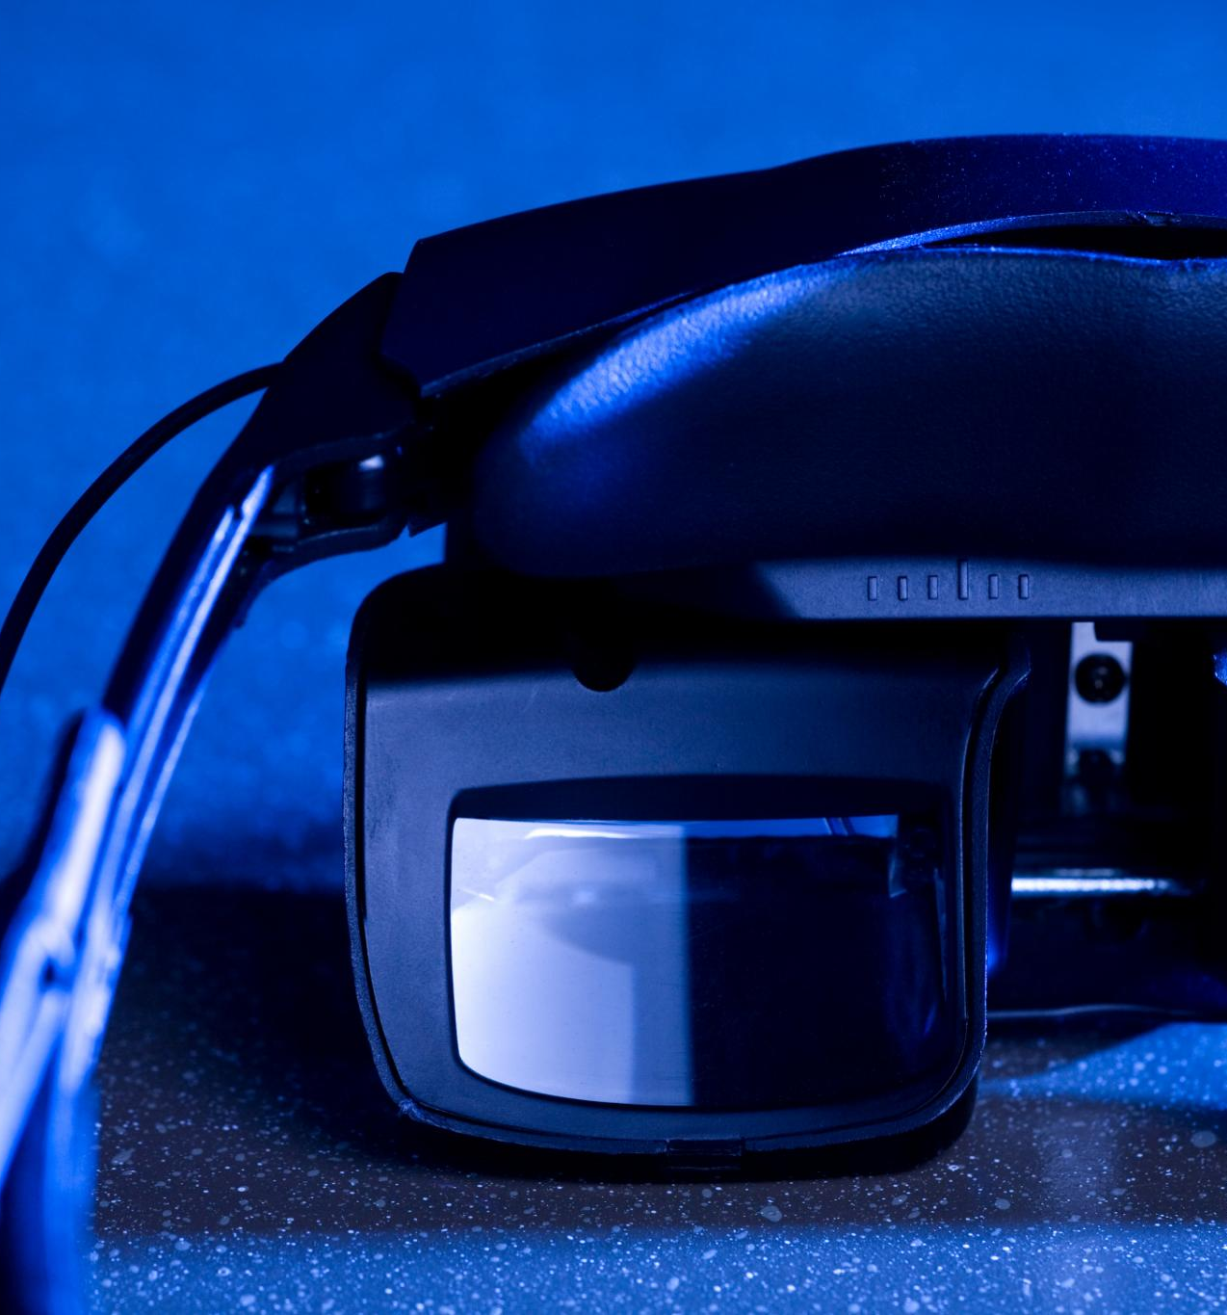
Impact on Mainstream Adoption of VR Platforms
Growth of VR Gaming
His contributions helped VR become a mainstream gaming platform with immersive user experiences.
Expansion to Tech Applications
VR technology expanded beyond gaming into wider tech fields like training, education, and design.
Mainstream VR Adoption
Overall, VR platforms saw significant mainstream acceptance and growth due to his visionary work.
Notes:
--- His work at Oculus contributed significantly to the mainstream acceptance and growth of VR platforms, influencing both gaming and wider tech applications. Image source: Microsoft 365 content library

Slide 19
Carmack’s Enduring Legacy and Influence
Notes:
John Carmack’s contributions continue to inspire developers and shape the technology landscape, fostering open knowledge and innovation.

Slide 20

Foundational Role in Modern 3D Game Engines
Performance Optimization
Carmack's principles focus strongly on optimizing game engine performance for smooth and responsive gameplay.
Engine Flexibility
Modern game engines provide flexibility, allowing developers to create diverse and complex game environments.
Immersive Visuals
Immersive and realistic visuals are a key focus, enhancing player experience and engagement.
Notes:
--- Many modern game engines build upon principles Carmack pioneered, emphasizing performance, flexibility, and immersive visuals. Image source: Microsoft 365 content library

Slide 21

Promotion of Open-Source Education for Developers
Open-Source Commitment
Carmack’s dedication to open-source initiatives promotes learning and sharing among developers globally.
Empowering Developers
Open-source projects provide tools and knowledge that empower developers to innovate and grow professionally.
Community Collaboration
Open-source fosters a global community where developers contribute and solve problems together.
Notes:
--- Carmack’s commitment to open-source projects has helped educate and empower countless developers around the world, driving community collaboration. Image source: Microsoft 365 content library

Slide 22

Continued Inspiration for Generations of Programmers
Innovative Spirit
His creativity drives programmers to explore new ideas and develop cutting-edge solutions in technology.
Technical Mastery
Mastery of technical skills motivates generations to excel in programming and technological development.
Impact on Gaming and Technology
His influence encourages pushing boundaries in gaming and technology industries worldwide.
Notes:
--- His innovative spirit and technical mastery inspire new generations to push boundaries in programming, gaming, and technology at large. Image source: Microsoft 365 content library

Slide 23
Conclusion
Innovation and Dedication
John Carmack's career exemplifies how passion and commitment drive technological breakthroughs and progress in gaming.
Impact on Gaming
His contributions have significantly influenced the gaming industry, shaping future technologies and experiences.
Notes:
John Carmack’s journey from a passionate programmer to a technology legend highlights the power of innovation and dedication. His impact on gaming and technology continues to shape the future.

